Slide 1
EE 304 Design Lab
Progress Presentation

Slide 2
Project Name : MEMS based Bio Sensor
Project Supervisor : Prof. Harshal B. Nemade
Group No. : 28
Team Members and their Roll Numbers :
1) Srijan Sankrit (170108046)
2) Aditya Uppala (170108039)
3) Sarvesh Choushetti (170108050)

Slide 3
The first part of the project is to use a SAW resonator for generating a square wave of very high frequency. (MHz Range) It has a touch surface which on sensing a stimuli, will change the output frequency by some amount. This is why, a high frequency output is required so that even a small change can be detected easily. The second part of the project is after detecting frequency changes, we need to calibrate it accordingly.
Project Description

Slide 4
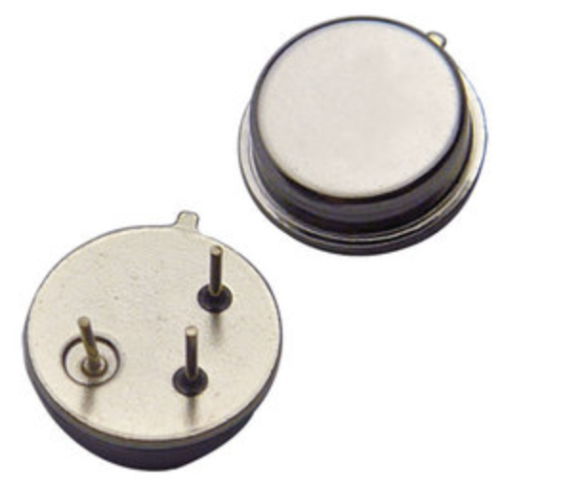
Components used
YXC R433 Surface Acoustic Wave Resonator 433.92 MHz ( 433.845 MHz to 433.995 MHz )
0603 SMD Capacitors
0603 SMD Resistances
0603 SMD Inductor
2SC4228 High Frequency Low Noise NPN Transistor
9V DC power supply
Designing!
Software used(till now)
Autodesk EAGLE (for designing the layout and circuit)

Slide 5
Challenges Faced
Our project required us to design a PCB layout, so we had to first find about the software used.
Having little to no knowledge about how the PCB Printing process works and what standards we had to follow for ease of printing.
Next challenge was there were some components which were not available, so we had to make a custom library for some of the components.

Slide 6
Progress of our team
We have successfully completed the designing phase of the circuit, which included designing the libraries and making the board layout.
The testing phase required us to be in college to work with the state-of-the-art instruments in our campus.

Slide 7
What is SAW Resonator?
A surface acoustic wave (SAW) is an acoustic wave traveling along the surface of a material exhibiting elasticity, with an amplitude that typically decays exponentially with depth into the material.
Two port SAW resonators are comprised of two IDTs (input/output) mounted in the center with reflectors arranged on both sides.
The two port SAW resonator is a low-loss, extremely narrow band-pass filter capable of easily achieving oscillation by combining the resonator with an amplifier to form a feedback loop.

Slide 8
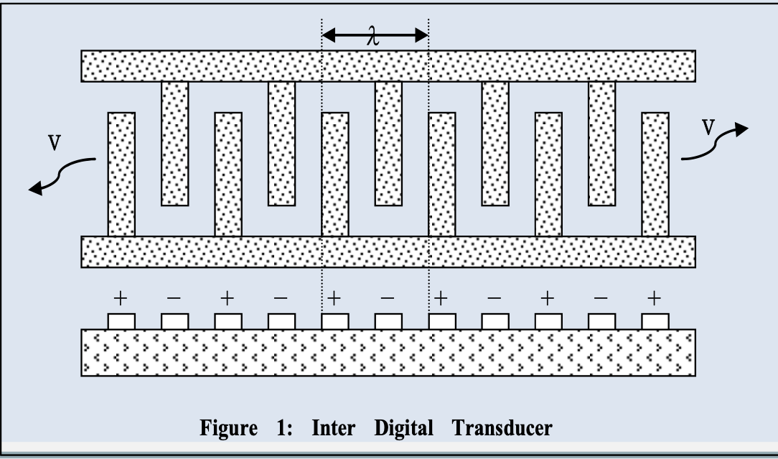
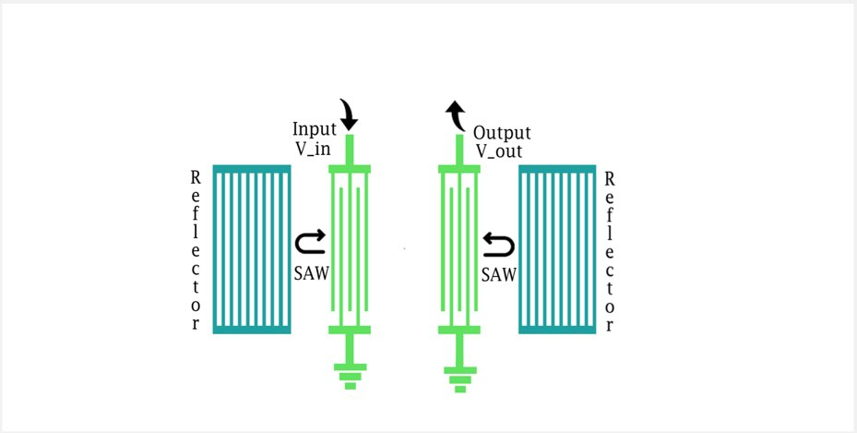
Working of SAW Resonator
Heart of these devices is inter digited transducer (IDT), which could be used as SAW transducer to convert external voltage to SAW on piezoelectric substrate and detect back piezoelectric voltage induced by SAW.
The wave properties strongly depend on the substrate material, the shape of the IDTs, and the material deposited on the piezoelectric substrate.

Slide 9
Working of SAW Resonator
External factors that can change the wave speed of the SAW is usually the formation of a thin layer deposited on the piezoelectric substrate on which the SAW is propagated.
When analytes interact with this thin layer, either the electric field has a small difference, or a mass loading effect is introduced.
In this way, the sensing of gases, chemicals, bio-molecules etc., are completed by sensing changes in conductivity of the sensing layer or by observing mass changes when specific molecules are absorbed
This kind of change is mostly measured by fabricating a kind of resonator and then measuring the change in the resonance frequency.

Slide 10
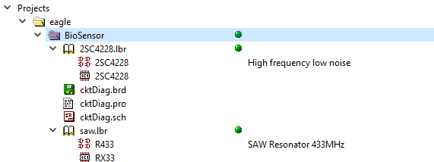
Project Folder Structure

Slide 11
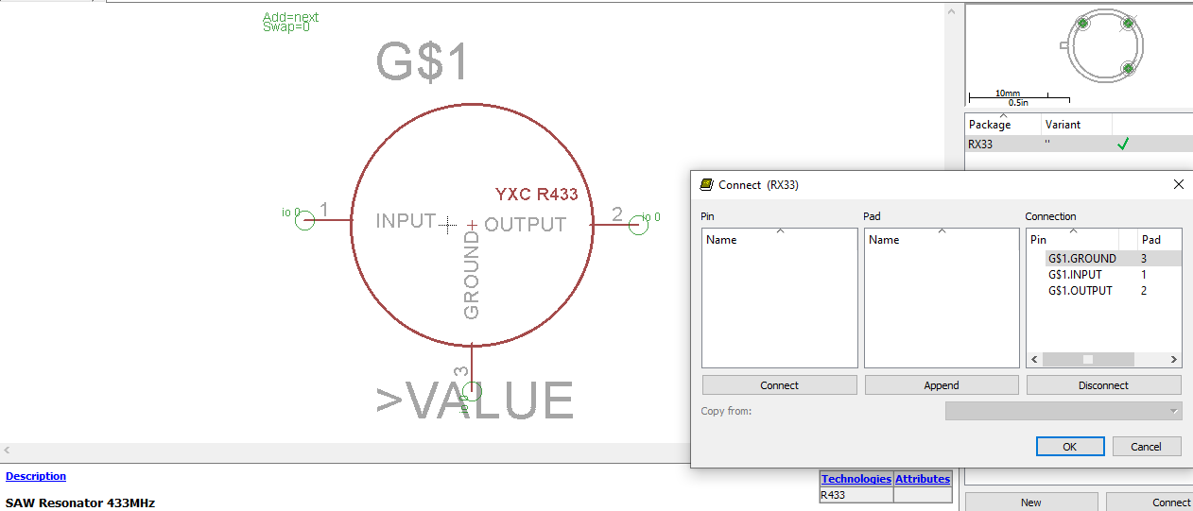
Custom Library Design
SAW Resonator Library

Slide 12
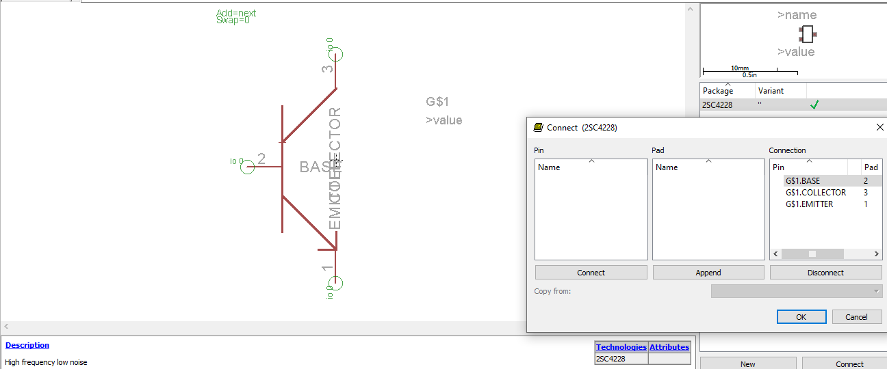
Custom Library Design
2SC4228 Transistor

Slide 13
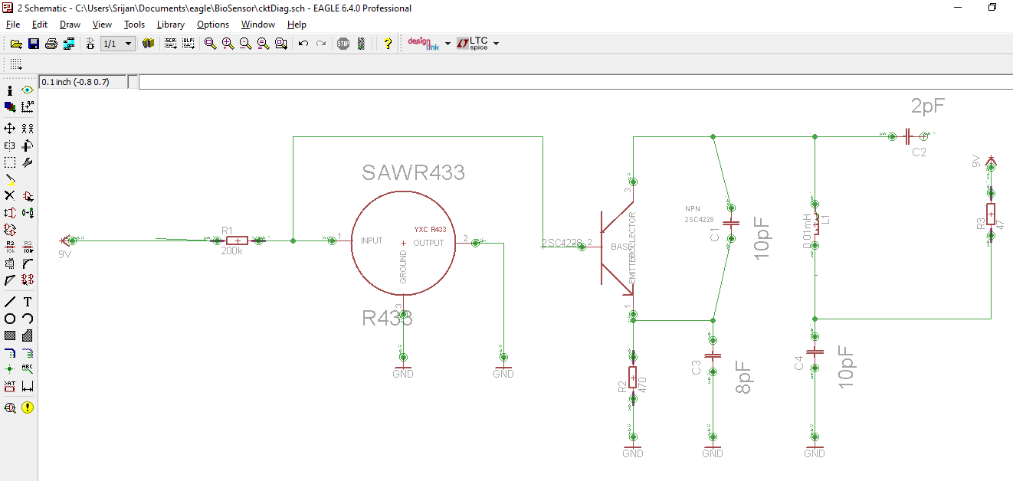
Schematic Design

Slide 14
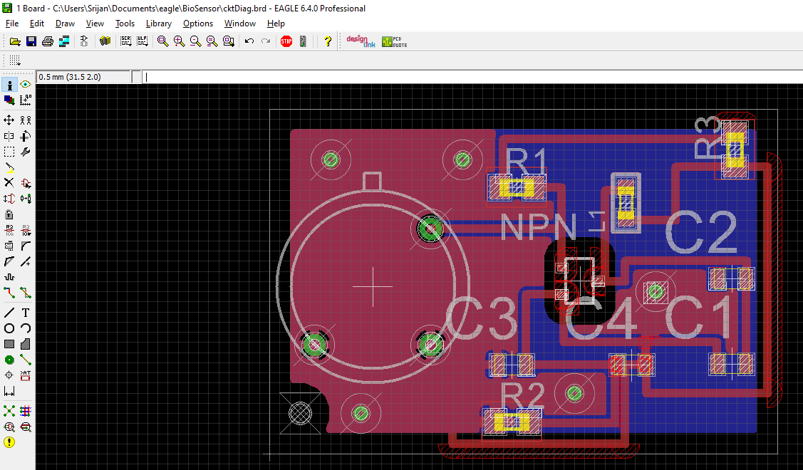
Board Layout

Slide 15
References
SAW Resonator Working -> http://www.jos.ac.cn/app/article/app/doi/10.1088/1674-4926/37/2/021001?pageType=en
https://www5.epsondevice.com/en/information/technical_info/pdf/tech_notes201306saw_.pdf
YXC R433 Datasheet -> https://www.evelta.com/content/datasheets/087-RTO3943392MA3SI-W.pdf
2SC4228 Datasheet -> ( http://www.datasheetcatalog.com/datasheets_pdf/2/S/C/4/2SC4228.shtml )

Slide 16
Thank You!

